Slide 1
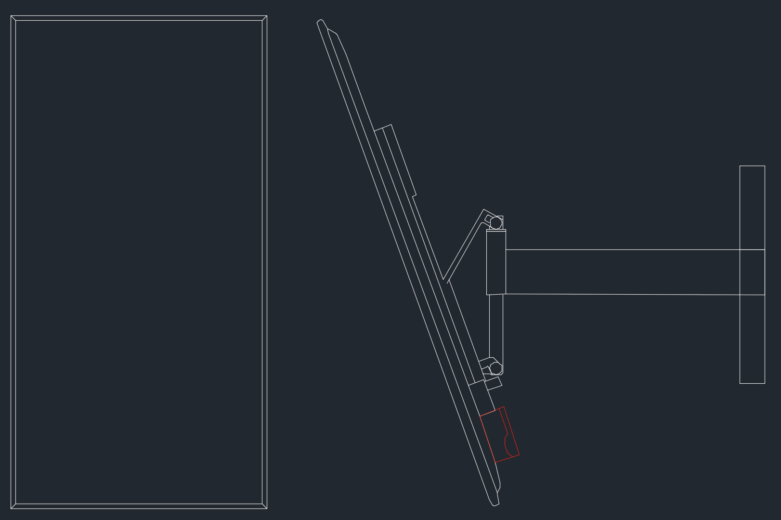
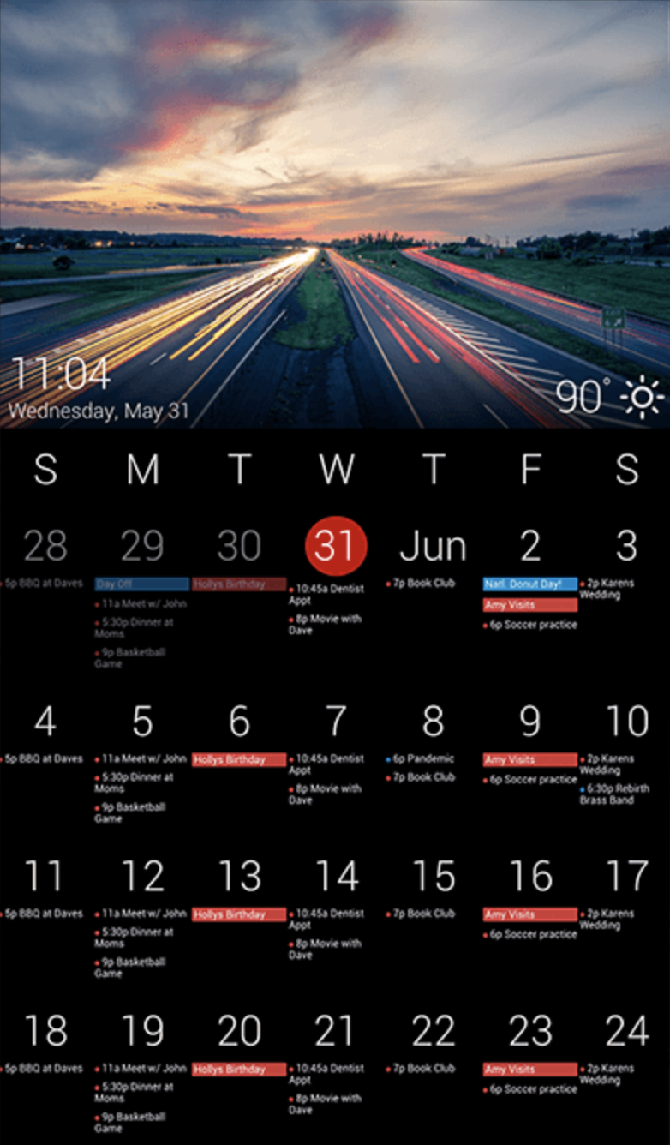
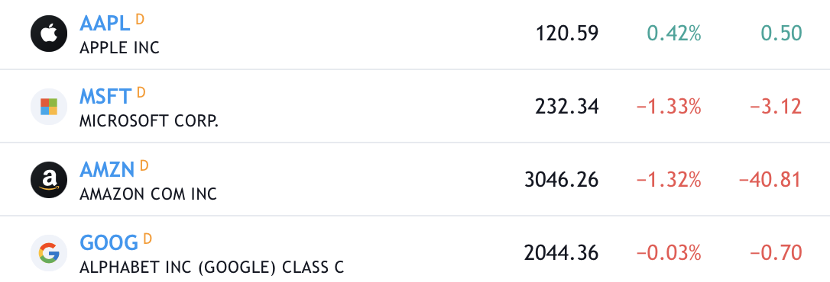
Raspberry Pi mounted on back of monitor.
24 inch monitor. 21.2” x 20.5”

